Slide 2
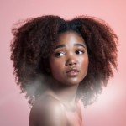
(HERO CLONE) Survey time... Tell us your beauty preferences 24.01.2022 -> 31.07.2023

Slide 3
Info Image
So, this brief will ask you all about your makeup routine!
Question type: Info Image Sample: Beauty Club | 24/01/2022 - 31/07/2023
Go to dashboard
Get in touch: hello@bulbshare.com
3

